Slide 1


Web Programming 2x1
JavaScript Operators

Slide 2
Outcomes
Students should understand the following outcomes, upon successful completion of this module:
Operators’ precedence
Assignment Operators
Comparison Operators
Arithmetic operators
Concatenation Operators
Logical Operators
Combining Operators

Slide 3
Operators in JavaScript
Operators are symbols that perform operations on operands (values and variables).
They are categorized into different types based on their functionality
Operators precedence is essential for writing efficient and correct code.
JavaScript contains:
Binary Operator
A binary operator operates on two operands. It appears between two operands, which can be variables, literals, or expressions.
Arithmetic Operators: +, -, *, /, %
Comparison Operators: ==, !=, >, <, >=, <=

Slide 4

Equality Operators
Both == and === are used for comparison, but they differ in terms of strictness and type coercion.
Loose Equality Operator ==
The == operator checks for equality between two operands after performing type coercion if necessary.
It tries to convert the operands to the same type before making the comparison.

Slide 5

Comparison Operators
Strict Equality Operator ===
The === operator checks for equality between two operands without performing type coercion. It compares both the values and the types of the operands.
Key Differences
Type Coercion: == performs type coercion, meaning it may convert operands to a common type before comparison.
Strictness: === checks both value and type, ensuring both operands are exactly the same.
=== does not perform type coercion.

Slide 6

Operators in JavaScript
Unary Operator
A unary operator operates on a single operand. It appears before or after its operand.
Increment and Decrement Operators: ++, --
Logical NOT Operator: !
Ternary Conditional Operator
The ternary conditional operator ( ? : ) is unique in JavaScript as it takes three operands.
It evaluates a condition and returns one of two expressions, depending on whether the condition is true or false.
Syntax:

Slide 7
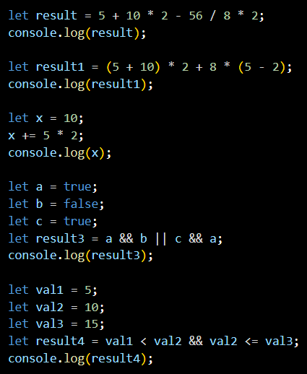
Operator Precedence
Operator precedence in JavaScript determines the order in which operators are evaluated when multiple operators are used in an expression.
Operators with higher precedence are evaluated first.
If operators have the same precedence, they are evaluated from left to right.
Notes:
Results:
11
54
20
true
true

Slide 8
Thank You!
The End
/belgiumcampusSA
#Belgium Campus
info@belgiumcampus.ac.za
+27 10 593 53 68
/belgiumcampus

